Slide 2
Turing Machines
Definition
Examples

Slide 3
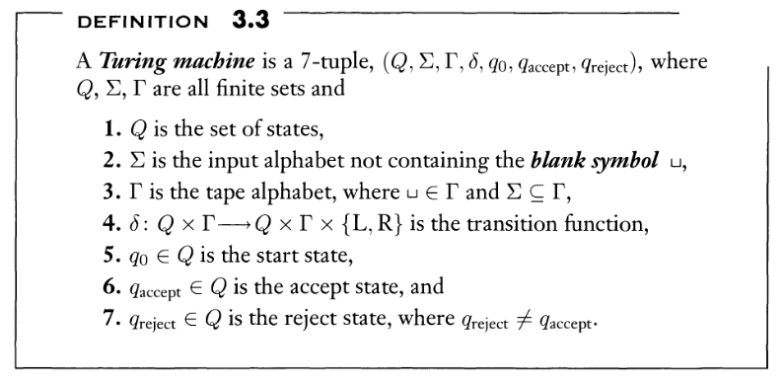

Slide 4
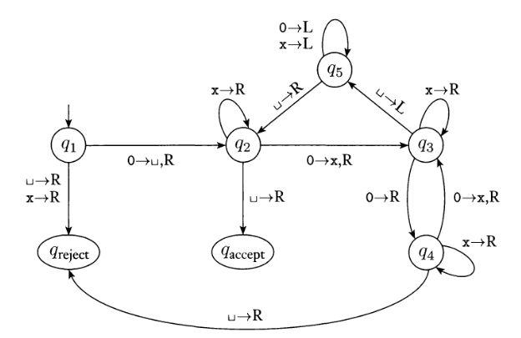

$$L=\left\{0^{2^{n}} | n≥0\right\}$$

Slide 5
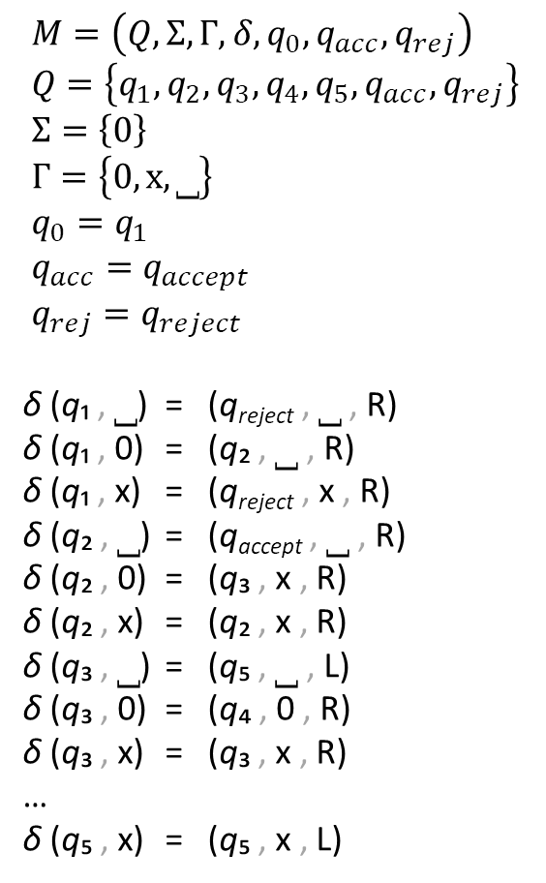
$M=\left(Q,Σ,Γ,δ,q_{0},q_{acc},q_{rej}\right)$
$Q=\left\{q_{1},q_{2},q_{3},q_{4},q_{5},q_{acc},q_{rej}\right\}$
$Σ=\left\{0\right\}$
$Γ=\left\{0,x,⎵\right\}$
$q_{0}=q_{1}$
$q_{acc}=q_{accept}$
$q_{rej}=q_{reject}$
δ (q₁ , ⎵) = (q_{reject} , ⎵ , R)
δ (q₁ , 0) = (q₂ , ⎵ , R)
δ (q₁ , x) = (q_{reject} , x , R)
δ (q₂ , ⎵) = (q_{accept} , ⎵ , R)
δ (q₂ , 0) = (q₃ , x , R)
δ (q₂ , x) = (q₂ , x , R)
δ (q₃ , ⎵) = (q₅ , ⎵ , L)
δ (q₃ , 0) = (q₄ , 0 , R)
δ (q₃ , x) = (q₃ , x , R)
…
δ (q₅ , x) = (q₅ , x , L)

Slide 6
Build a TM that recognizes $L=\left\{w\#w|w∈{\left\{0,1\right\}}^{∗}\right\}$
Idea: Compare the left and right sides symbol-by-symbol,
crossing them out afterwards

Slide 7
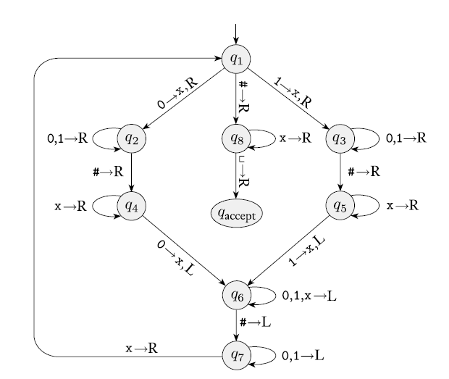
Build a TM that recognizes $L=\left\{w\#w|w∈{\left\{0,1\right\}}^{∗}\right\}$
1
0
0
1
#
1
0
0
1
_
_

Slide 8
Build a TM that recognizes $L=\left\{w\#w|w∈{\left\{0,1\right\}}^{∗}\right\}$
x
0
0
1
#
1
0
0
1
_
_

Slide 9
Build a TM that recognizes $L=\left\{w\#w|w∈{\left\{0,1\right\}}^{∗}\right\}$
x
0
0
1
#
1
0
0
1
_
_

Slide 10
Build a TM that recognizes $L=\left\{w\#w|w∈{\left\{0,1\right\}}^{∗}\right\}$
x
0
0
1
#
1
0
0
1
_
_

Slide 11
Build a TM that recognizes $L=\left\{w\#w|w∈{\left\{0,1\right\}}^{∗}\right\}$
x
0
0
1
#
x
0
0
1
_
_

Slide 12

Build a TM that recognizes $L=\left\{w\#w|w∈{\left\{0,1\right\}}^{∗}\right\}$
x
0
0
1
#
x
0
0
1
_
_
$$δ\left(q_{1},_\right)=\left(q_{reject},R\right)$$

Slide 13
Build a TM that recognizes $L=\left\{w\#w|w∈{\left\{0,1\right\}}^{∗}\right\}$
x
0
0
1
#
x
0
0
1
_
_

Slide 14
Build a TM that recognizes $L=\left\{w\#w|w∈{\left\{0,1\right\}}^{∗}\right\}$
x
0
0
1
#
x
0
0
1
_
_

Slide 15
Build a TM that recognizes $L=\left\{w\#w|w∈{\left\{0,1\right\}}^{∗}\right\}$
x
x
0
1
#
x
0
0
1
_
_

Slide 16
Build a TM that recognizes $L=\left\{w\#w|w∈{\left\{0,1\right\}}^{∗}\right\}$
x
x
0
1
#
x
0
0
1
_
_

Slide 17
Build a TM that recognizes $L=\left\{w\#w|w∈{\left\{0,1\right\}}^{∗}\right\}$
x
x
0
1
#
x
0
0
1
_
_

Slide 18
Build a TM that recognizes $L=\left\{w\#w|w∈{\left\{0,1\right\}}^{∗}\right\}$
x
x
0
1
#
x
x
0
1
_
_

Slide 19
Build a TM that recognizes $L=\left\{w\#w|w∈{\left\{0,1\right\}}^{∗}\right\}$
x
x
0
1
#
x
x
0
1
_
_

Slide 20
Build a TM that recognizes $L=\left\{w\#w|w∈{\left\{0,1\right\}}^{∗}\right\}$
x
x
x
x
#
x
x
x
x
_
_

Slide 21
Build a TM that recognizes $L=\left\{w\#w|w∈{\left\{0,1\right\}}^{∗}\right\}$
x
x
x
x
#
x
x
x
x
_
_

Slide 22
Build a TM that recognizes $L=\left\{w\#w|w∈{\left\{0,1\right\}}^{∗}\right\}$
x
x
x
x
#
x
x
x
x
_
_

Slide 23
Build a TM that recognizes $L=\left\{w\#w|w∈{\left\{0,1\right\}}^{∗}\right\}$
x
x
x
x
#
x
x
x
x
_
_

Slide 24
Build a TM that recognizes $L=\left\{w\#w|w∈{\left\{0,1\right\}}^{∗}\right\}$
x
x
x
x
#
x
x
x
x
_
_

Slide 25
Build a TM that recognizes $L=\left\{w\#w|w∈{\left\{0,1\right\}}^{∗}\right\}$
x
x
x
x
#
x
x
x
x
_
_

Slide 26
Build a TM that recognizes $L=\left\{w\#w|w∈{\left\{0,1\right\}}^{∗}\right\}$
x
x
x
x
#
x
x
x
x
_
_
1
0
0
1
#
1
0
0
1
1
_
x
x
x
x
#
x
x
x
x
1
_

Slide 27
Build a TM that recognizes $L=\left\{w\#w|w∈{\left\{0,1\right\}}^{∗}\right\}$
1
0
x
x
#
1
0
0
x
x
_
x
x
x
1
#
x
x
x
x
1
_

Slide 28
Some important notions
Turing Machine
Description of a TM
Configuration of TM
Halting of TM
Recognition and Deciding
Recursively enumerable languages and Recursive languages

Slide 29
Turing machines
A 7-tuple (Q, Σ, Γ, δ, q₀, q_{accept}, q_{reject})
For simplicity, we can omit q_{reject} and the corresponding arrows

Slide 30
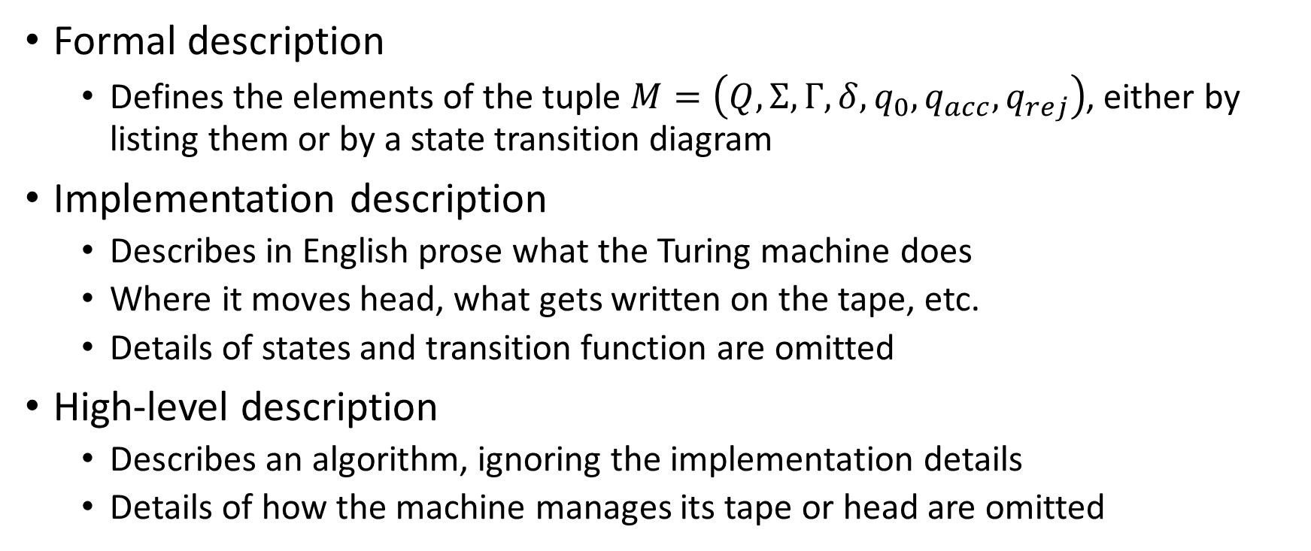
Describing Turing machines
Formal description
Defines the elements of the tuple $M=\left(Q,Σ,Γ,δ,q_{0},q_{acc},q_{rej}\right)$, either by listing them or by a state transition diagram
Implementation description
Describes in English prose what the Turing machine does
Where it moves head, what gets written on the tape, etc.
Details of states and transition function are omitted
High-level description
Describes an algorithm, ignoring the implementation details
Details of how the machine manages its tape or head are omitted

Slide 31
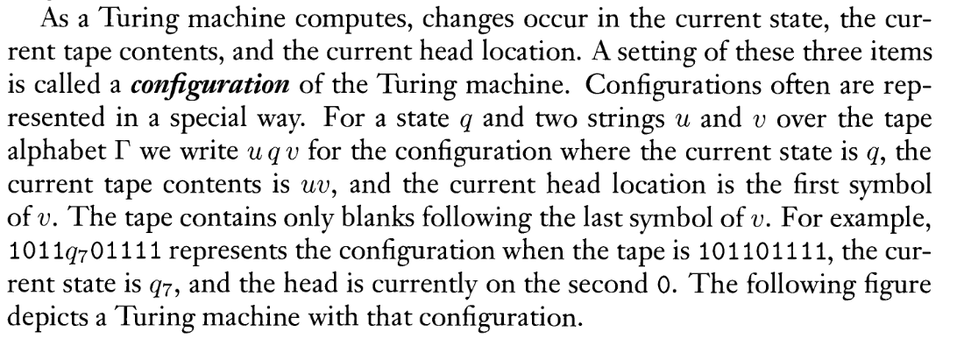
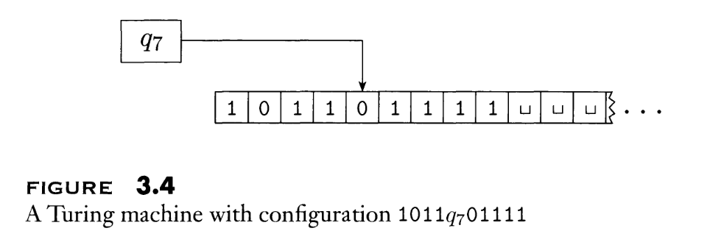
Configuration of TM
TM current state
Contents of the tape
Position of the head

Slide 32
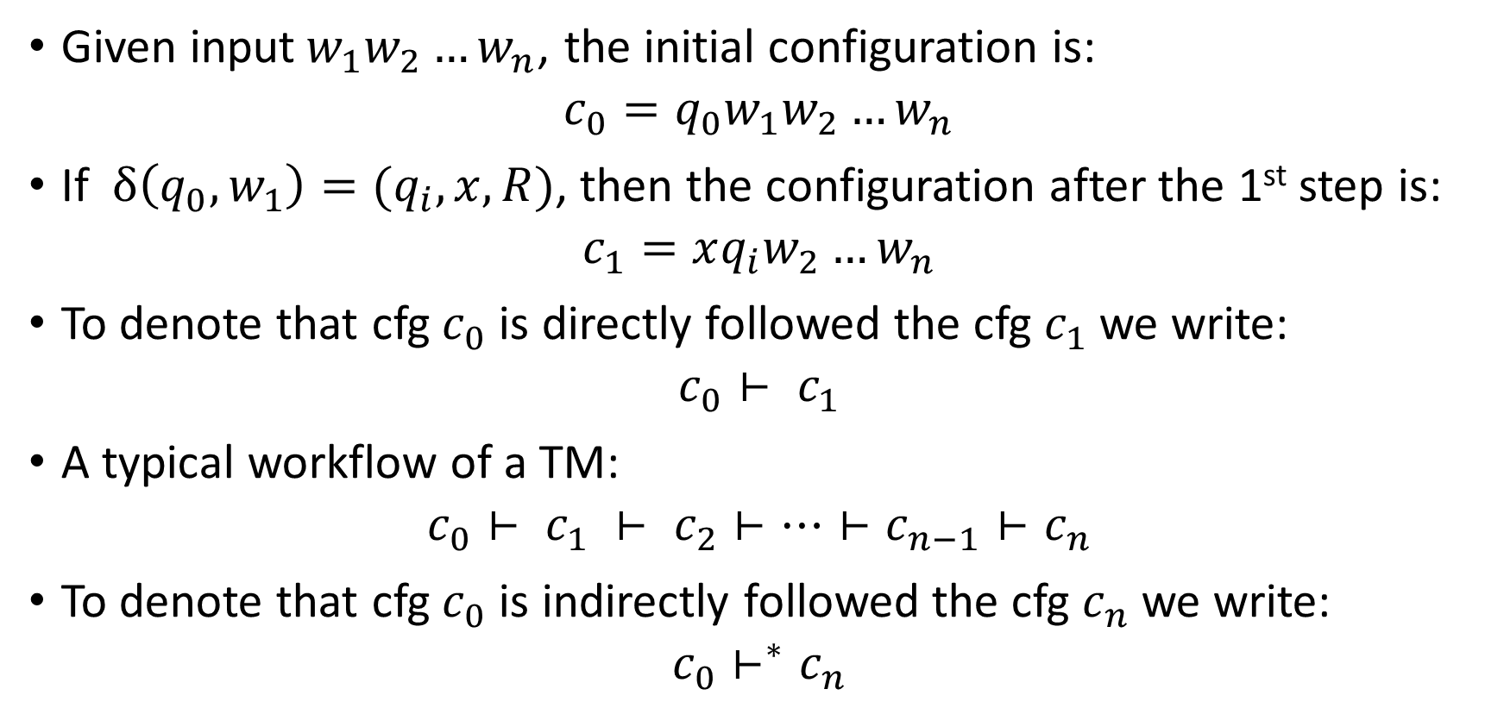
Configuration of TM
Given input$w_{1}w_{2}…w_{n}$, the initial configuration is:
$$c_{0}=q_{0}w_{1}w_{2}…w_{n}$$
If $δ\left(q_{0},w_{1}\right)={(q}_{i},x,R)$, then the configuration after the 1st step is:
$$c_{1}=xq_{i}w_{2}…w_{n}$$
To denote that cfg $c_{0}$ is directly followed the cfg $c_{1}$ we write:
$$c_{0}⊢ c_{1}$$
A typical workflow of a TM:
$$c_{0}⊢ c_{1} ⊢ c_{2}⊢…⊢c_{n−1}⊢c_{n}$$
To denote that cfg $c_{0}$ is indirectly followed the cfg $c_{n}$ we write:
$$c_{0}⊢^{∗}c_{n}$$

Slide 33
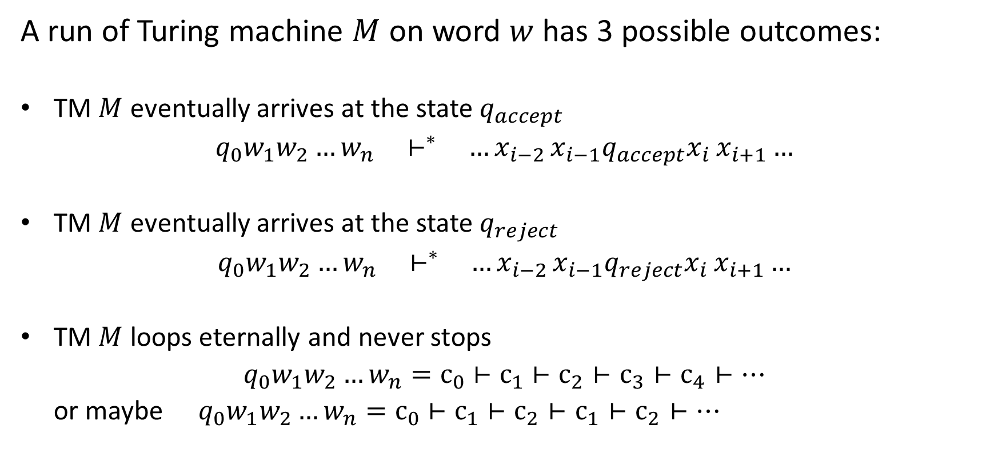
Halting of a TM
A run of Turing machine $M$ on word $w$ has 3 possible outcomes:
TM $M$ eventually arrives at the state $q_{accept}$
$q_{0}w_{1}w_{2}…w_{n} { ⊢}^{∗}$ ${…x}_{i−2}x_{i−1}q_{accept}x_{i}$ $x_{i+1}…$
TM $M$ eventually arrives at the state $q_{reject}$
$q_{0}w_{1}w_{2}…w_{n} { ⊢}^{∗}$ ${…x}_{i−2}x_{i−1}q_{reject}x_{i}$ $x_{i+1}…$
TM $M$ loops eternally and never stops
$q_{0}w_{1}w_{2}…w_{n}=с_{0}$ $⊢с_{1}$ $⊢с_{2}⊢с_{3}⊢с_{4}⊢…$
or maybe $q_{0}w_{1}w_{2}…w_{n}=с_{0}$ $⊢с_{1}$ $⊢с_{2}⊢с_{1}⊢с_{2}⊢…$

Slide 34

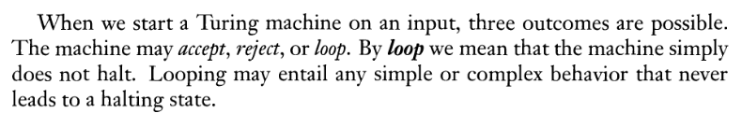
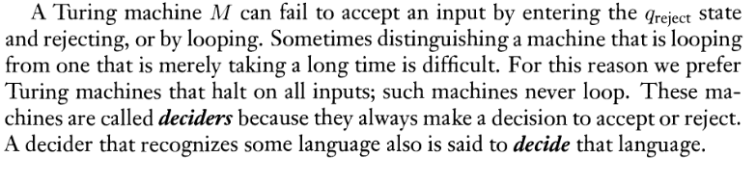
Languages recognized / decided by TM

Slide 35

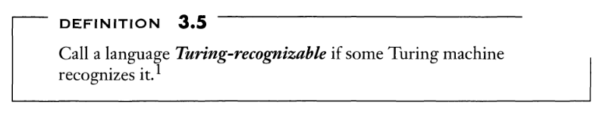
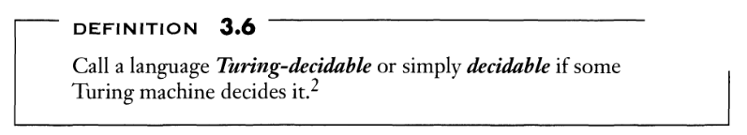
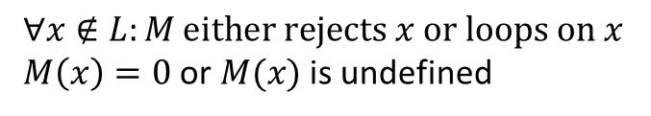
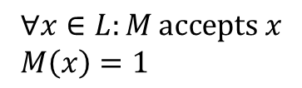
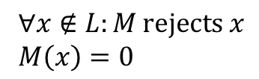
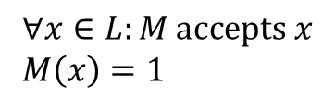
Languages recognized / decided by TM
$$∀x∈L:M \text{accepts} x$$
$M\left(x\right)=1$
$∀x∉L:M \text{either} \text{rejects} x \text{or} \text{loops} \text{on} x$
$M\left(x\right)=0$ or $M(x)$ is undefined
$$∀x∈L:M \text{accepts} x$$
$M\left(x\right)=1$
$∀x∉L:M \text{rejects} x$
$M\left(x\right)=0$

Slide 36
“Improvements” for TM
Additional transition
Two-side-infinite tape
Multiple tapes
Nondeterministic behavior

Slide 37
Variants of TM
Allowed transitions {L,R} vs {L,N,R}
N transition can be replaced by two transitions (R,L)

Slide 38
Variants of TM
Allowed transitions {L,R} vs {L,N,R}
N transition can be replaced by two transitions (R,L)
Doubly-infinite tape vs singly-infinite tape
a
b
c
a
b
_
_
_
…
…
_
_
a
b
c
a
b
_
_
_
…

Slide 39


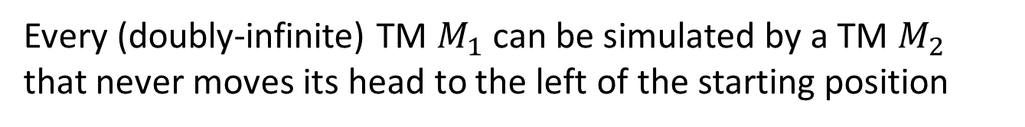
Every (doubly-infinite) TM $M_{1}$ can be simulated by a TM $M_{2}$ that never moves its head to the left of the starting position
Add a special symbol $\underline{∗}$
When starting, TM $M_{2}$ writes $\underline{∗}$ in the first cell and shifts all other content to the right, then goes to the first position and simulates $M_{1}$
a
b
c
a
b
_
_
_
…
$$\underline{∗}$$
a
b
c
a
b
_
_
…

Slide 40
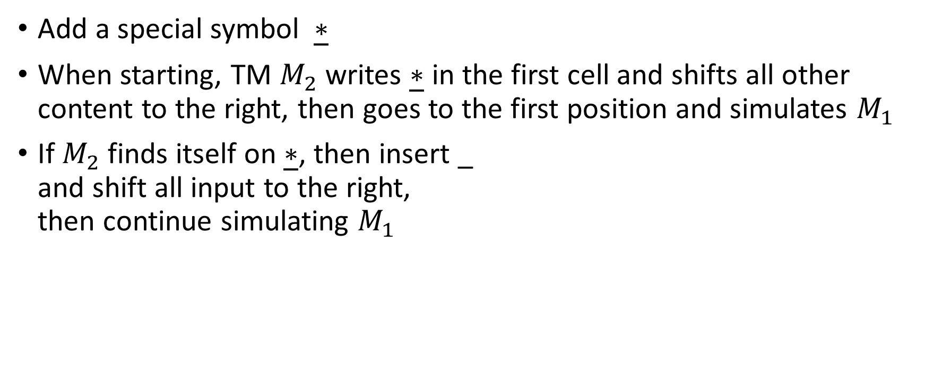


Every (doubly-infinite) TM $M_{1}$ can be simulated by a TM $M_{2}$ that never moves its head to the left of the starting position
Add a special symbol $\underline{∗}$
When starting, TM $M_{2}$ writes $\underline{∗}$ in the first cell and shifts all other content to the right, then goes to the first position and simulates $M_{1}$
If $M_{2}$ finds itself on $\underline{∗}$, then insert _ and shift all input to the right, then continue simulating $M_{1}$
a
b
c
a
b
_
_
_
…
$$\underline{∗}$$
a
b
c
a
b
_
_
…
$$\underline{∗}$$
x
b
a
a
b
_
_
…
$$\underline{∗}$$
_
x
b
a
a
b
_
…

Slide 41


Every (doubly-infinite) TM $M_{1}$ can be simulated by a TM $M_{2}$ that never moves its head to the left of the starting position
Add a special symbol $\underline{∗}$
When starting, TM $M_{2}$ writes $\underline{∗}$ in the first cell and shifts all other content to the right, then goes to the first position and simulates $M_{1}$
If $M_{2}$ finds itself on $\underline{∗}$, then insert _ and shift all input to the right, then continue simulating $M_{1}$
a
b
c
a
b
_
_
_
…
$$\underline{∗}$$
a
b
c
a
b
_
_
…
$$\underline{∗}$$
x
b
a
a
b
_
_
_
a
b
_
_
_
…
b
_
_
_
a
b
_
…
$$\underline{∗}$$
_
x
b
a
a
_
…
…

Slide 42

Every (doubly-infinite) TM $M_{1}$ can be simulated by a TM $M_{2}$ that never moves its head to the left of the starting position
Add a special symbol $\underline{∗}$
When starting, TM $M_{2}$ writes $\underline{∗}$ in the first cell and shifts all other content to the right, then goes to the first position and simulates $M_{1}$
If $M_{2}$ finds itself on $\underline{∗}$, then insert _ and shift all input to the right, then continue simulating $M_{1}$
a
b
c
a
b
_
_
_
…
$$\underline{∗}$$
a
b
c
a
b
_
_
…
$$\underline{∗}$$
x
b
a
a
b
_
_
_
a
b
_
_
_
…
b
_
_
_
a
b
_
…
$$\underline{∗}$$
_
x
b
a
a
_
…
b
_
_
a
b
_
_
…
$$\underline{∗}$$
_
x
b
a
a
_
…

Slide 43








Simulating a doubly-infinite tape by a singly-infinite one
Note: to shift all content to the right, the TM has to know where the content ends (and the infinite sequence of _ _ _ _ … starts)
This can be solved by never writing _ on the tape but some other symbol $\underline{\sim }$ that is treated exactly like _ except for shifting subroutine
$$\underline{∗}$$
x
b
a
a
b
$$\underline{\sim }$$
$$\underline{\sim }$$
c
c
b
b
_
_
…
First genuine blank = End of data
$$\underline{∗}$$
$$\underline{\sim }$$
x
b
a
a
b
$$\underline{\sim }$$
$$\underline{\sim }$$
c
c
b
b
_
_
…

Slide 44
Simulating a doubly-infinite tape by a singly-infinite one

Slide 45
Build a TM that recognizes 𝐿 = {𝑥𝑦𝑧 𝑤 # 𝑥𝑦𝑧 𝑥𝑦𝑧 𝑤 | 𝑥,𝑦,𝑧∈{0,1}, 𝑤∈{0,1}∗}
High-level description (for a TM with doubly-infinite tape)
copy first three symbols to the left of the word, then solve {𝑤#𝑤|𝑤∈{0,1}∗}
Implementation description (for a TM with doubly-infinite tape)
1. move the head rightwards twice; 7. remember a binary digit, write x;
2. read and remember a binary digit; 8. move → until # (reject if found ⎵);
3. reject if it was # or ⎵ instead; 9. move → until 0 or 1 (reject on ⎵);
4. move the head leftwards until ⎵; 10. reject if it ≠ the remembered one;
5. write the digit; 11. write x;
6. repeat steps 1–5 twice more; 12. move ← until #;
13. move ← until x, then → once;
14. if there’s 0 or 1, return to step 7;
15. move → while there’s x;
16. accept on ⎵, reject on 0, 1

Slide 46
Build a TM that recognizes 𝐿 = {𝑥𝑦𝑧 𝑤 # 𝑥𝑦𝑧 𝑥𝑦𝑧 𝑤 | 𝑥,𝑦,𝑧∈{0,1}, 𝑤∈{0,1}∗}
High-level description (for a TM with doubly-infinite tape)
copy first three symbols to the left of the word, then solve {𝑤#𝑤|𝑤∈{0,1}∗}
Implementation description (for a TM with doubly-infinite tape)
1. move the head rightwards twice; 7. remember a binary digit, write x;
2. read and remember a binary digit; 8. move → until # (reject if found ⎵);
3. reject if it was # or ⎵ instead; 9. move → until 0 or 1 (reject on ⎵);
4. move the head leftwards until ⎵; 10. reject if it ≠ the remembered one;
5. write the digit; 11. write x;
6. repeat steps 1–5 twice more; 12. move ← until #;
13. move ← until x, then → once;
14. if there’s 0 or 1, return to step 7;
15. move → while there’s x;
16. accept on ⎵, reject on 0, 1

Slide 47
Build a TM that recognizes 𝐿 = {𝑥𝑦𝑧 𝑤 # 𝑥𝑦𝑧 𝑥𝑦𝑧 𝑤 | 𝑥,𝑦,𝑧∈{0,1}, 𝑤∈{0,1}∗}
High-level description (for a TM with doubly-infinite tape)
copy first three symbols to the left of the word, then solve {𝑤#𝑤|𝑤∈{0,1}∗}
Implementation description (for a TM with doubly-infinite tape)
1. move the head rightwards twice; 7. remember a binary digit, write x;
2. read and remember a binary digit; 8. move → until # (reject if found ⎵);
3. reject if it was # or ⎵ instead; 9. move → until 0 or 1 (reject on ⎵);
4. move the head leftwards until ⎵; 10. reject if it ≠ the remembered one;
5. write the digit; 11. write x;
6. repeat steps 1–5 twice more; 12. move ← until #;
13. move ← until x, then → once;
14. if there’s 0 or 1, return to step 7;
15. move → while there’s x;
16. accept on ⎵, reject on 0, 1

Slide 48
Build a TM that recognizes 𝐿 = {𝑥𝑦𝑧 𝑤 # 𝑥𝑦𝑧 𝑥𝑦𝑧 𝑤 | 𝑥,𝑦,𝑧∈{0,1}, 𝑤∈{0,1}∗}
High-level description (for a TM with doubly-infinite tape)
copy first three symbols to the left of the word, then solve {𝑤#𝑤|𝑤∈{0,1}∗}
Implementation description (for a TM with doubly-infinite tape)
1. move the head rightwards twice; 7. remember a binary digit, write x;
2. read and remember a binary digit; 8. move → until # (reject if found ⎵);
3. reject if it was # or ⎵ instead; 9. move → until 0 or 1 (reject on ⎵);
4. move the head leftwards until ⎵; 10. reject if it ≠ the remembered one;
5. write the digit; 11. write x;
6. repeat steps 1–5 twice more; 12. move ← until #;
13. move ← until x, then → once;
14. if there’s 0 or 1, return to step 7;
15. move → while there’s x;
16. accept on ⎵, reject on 0, 1

Slide 49
Build a TM that recognizes 𝐿 = {𝑥𝑦𝑧 𝑤 # 𝑥𝑦𝑧 𝑥𝑦𝑧 𝑤 | 𝑥,𝑦,𝑧∈{0,1}, 𝑤∈{0,1}∗}
High-level description (for a TM with doubly-infinite tape)
copy first three symbols to the left of the word, then solve {𝑤#𝑤|𝑤∈{0,1}∗}
Implementation description (for a TM with doubly-infinite tape)
1. move the head rightwards twice; 7. remember a binary digit, write x;
2. read and remember a binary digit; 8. move → until # (reject if found ⎵);
3. reject if it was # or ⎵ instead; 9. move → until 0 or 1 (reject on ⎵);
4. move the head leftwards until ⎵; 10. reject if it ≠ the remembered one;
5. write the digit; 11. write x;
6. repeat steps 1–5 twice more; 12. move ← until #;
13. move ← until x, then → once;
14. if there’s 0 or 1, return to step 7;
15. move → while there’s x;
16. accept on ⎵, reject on 0, 1

Slide 50
Build a TM that recognizes 𝐿 = {𝑥𝑦𝑧 𝑤 # 𝑥𝑦𝑧 𝑥𝑦𝑧 𝑤 | 𝑥,𝑦,𝑧∈{0,1}, 𝑤∈{0,1}∗}
High-level description (for a TM with doubly-infinite tape)
copy first three symbols to the left of the word, then solve {𝑤#𝑤|𝑤∈{0,1}∗}
Implementation description (for a TM with doubly-infinite tape)
1. move the head rightwards twice; 7. remember a binary digit, write x;
2. read and remember a binary digit; 8. move → until # (reject if found ⎵);
3. reject if it was # or ⎵ instead; 9. move → until 0 or 1 (reject on ⎵);
4. move the head leftwards until ⎵; 10. reject if it ≠ the remembered one;
5. write the digit; 11. write x;
6. repeat steps 1–5 twice more; 12. move ← until #;
13. move ← until x, then → once;
14. if there’s 0 or 1, return to step 7;
15. move → while there’s x;
16. accept on ⎵, reject on 0, 1

Slide 51
Build a TM that recognizes 𝐿 = {𝑥𝑦𝑧 𝑤 # 𝑥𝑦𝑧 𝑥𝑦𝑧 𝑤 | 𝑥,𝑦,𝑧∈{0,1}, 𝑤∈{0,1}∗}
High-level description (for a TM with doubly-infinite tape)
copy first three symbols to the left of the word, then solve {𝑤#𝑤|𝑤∈{0,1}∗}
Implementation description (for a TM with doubly-infinite tape)
1. move the head rightwards twice; 7. remember a binary digit, write x;
2. read and remember a binary digit; 8. move → until # (reject if found ⎵);
3. reject if it was # or ⎵ instead; 9. move → until 0 or 1 (reject on ⎵);
4. move the head leftwards until ⎵; 10. reject if it ≠ the remembered one;
5. write the digit; 11. write x;
6. repeat steps 1–5 twice more; 12. move ← until #;
13. move ← until x, then → once;
14. if there’s 0 or 1, return to step 7;
15. move → while there’s x;
16. accept on ⎵, reject on 0, 1

Slide 52
Build a TM that recognizes 𝐿 = {𝑥𝑦𝑧 𝑤 # 𝑥𝑦𝑧 𝑥𝑦𝑧 𝑤 | 𝑥,𝑦,𝑧∈{0,1}, 𝑤∈{0,1}∗}
High-level description (for a TM with doubly-infinite tape)
copy first three symbols to the left of the word, then solve {𝑤#𝑤|𝑤∈{0,1}∗}
Implementation description (for a TM with doubly-infinite tape)
1. move the head rightwards twice; 7. remember a binary digit, write x;
2. read and remember a binary digit; 8. move → until # (reject if found ⎵);
3. reject if it was # or ⎵ instead; 9. move → until 0 or 1 (reject on ⎵);
4. move the head leftwards until ⎵; 10. reject if it ≠ the remembered one;
5. write the digit; 11. write x;
6. repeat steps 1–5 twice more; 12. move ← until #;
13. move ← until x, then → once;
14. if there’s 0 or 1, return to step 7;
15. move → while there’s x;
16. accept on ⎵, reject on 0, 1

Slide 53
Build a TM that recognizes 𝐿 = {𝑥𝑦𝑧 𝑤 # 𝑥𝑦𝑧 𝑥𝑦𝑧 𝑤 | 𝑥,𝑦,𝑧∈{0,1}, 𝑤∈{0,1}∗}
High-level description (for a TM with doubly-infinite tape)
copy first three symbols to the left of the word, then solve {𝑤#𝑤|𝑤∈{0,1}∗}
Implementation description (for a TM with doubly-infinite tape)
1. move the head rightwards twice; 7. remember a binary digit, write x;
2. read and remember a binary digit; 8. move → until # (reject if found ⎵);
3. reject if it was # or ⎵ instead; 9. move → until 0 or 1 (reject on ⎵);
4. move the head leftwards until ⎵; 10. reject if it ≠ the remembered one;
5. write the digit; 11. write x;
6. repeat steps 1–5 twice more; 12. move ← until #;
13. move ← until x, then → once;
14. if there’s 0 or 1, return to step 7;
15. move → while there’s x;
16. accept on ⎵, reject on 0, 1

Slide 54
Build a TM that recognizes 𝐿 = {𝑥𝑦𝑧 𝑤 # 𝑥𝑦𝑧 𝑥𝑦𝑧 𝑤 | 𝑥,𝑦,𝑧∈{0,1}, 𝑤∈{0,1}∗}
High-level description (for a TM with doubly-infinite tape)
copy first three symbols to the left of the word, then solve {𝑤#𝑤|𝑤∈{0,1}∗}
Implementation description (for a TM with doubly-infinite tape)
1. move the head rightwards twice; 7. remember a binary digit, write x;
2. read and remember a binary digit; 8. move → until # (reject if found ⎵);
3. reject if it was # or ⎵ instead; 9. move → until 0 or 1 (reject on ⎵);
4. move the head leftwards until ⎵; 10. reject if it ≠ the remembered one;
5. write the digit; 11. write x;
6. repeat steps 1–5 twice more; 12. move ← until #;
13. move ← until x, then → once;
14. if there’s 0 or 1, return to step 7;
15. move → while there’s x;
16. accept on ⎵, reject on 0, 1

Slide 55
Build a TM that recognizes 𝐿 = {𝑥𝑦𝑧 𝑤 # 𝑥𝑦𝑧 𝑥𝑦𝑧 𝑤 | 𝑥,𝑦,𝑧∈{0,1}, 𝑤∈{0,1}∗}
High-level description (for a TM with doubly-infinite tape)
copy first three symbols to the left of the word, then solve {𝑤#𝑤|𝑤∈{0,1}∗}
Implementation description (for a TM with doubly-infinite tape)
1. move the head rightwards twice; 7. remember a binary digit, write x;
2. read and remember a binary digit; 8. move → until # (reject if found ⎵);
3. reject if it was # or ⎵ instead; 9. move → until 0 or 1 (reject on ⎵);
4. move the head leftwards until ⎵; 10. reject if it ≠ the remembered one;
5. write the digit; 11. write x;
6. repeat steps 1–5 twice more; 12. move ← until #;
13. move ← until x, then → once;
14. if there’s 0 or 1, return to step 7;
15. move → while there’s x;
16. accept on ⎵, reject on 0, 1

Slide 56
Build a TM that recognizes 𝐿 = {𝑥𝑦𝑧 𝑤 # 𝑥𝑦𝑧 𝑥𝑦𝑧 𝑤 | 𝑥,𝑦,𝑧∈{0,1}, 𝑤∈{0,1}∗}
High-level description (for a TM with doubly-infinite tape)
copy first three symbols to the left of the word, then solve {𝑤#𝑤|𝑤∈{0,1}∗}
Implementation description (for a TM with doubly-infinite tape)
1. move the head rightwards twice; 7. remember a binary digit, write x;
2. read and remember a binary digit; 8. move → until # (reject if found ⎵);
3. reject if it was # or ⎵ instead; 9. move → until 0 or 1 (reject on ⎵);
4. move the head leftwards until ⎵; 10. reject if it ≠ the remembered one;
5. write the digit; 11. write x;
6. repeat steps 1–5 twice more; 12. move ← until #;
13. move ← until x, then → once;
14. if there’s 0 or 1, return to step 7;
15. move → while there’s x;
16. accept on ⎵, reject on 0, 1
Now check if input ∈ {𝑤#𝑤} !

Slide 57
Build a TM that recognizes 𝐿 = {𝑥𝑦𝑧 𝑤 # 𝑥𝑦𝑧 𝑥𝑦𝑧 𝑤 | 𝑥,𝑦,𝑧∈{0,1}, 𝑤∈{0,1}∗}
High-level description (for a TM with doubly-infinite tape)
copy first three symbols to the left of the word, then solve {𝑤#𝑤|𝑤∈{0,1}∗}
Implementation description (for a TM with doubly-infinite tape)
1. move the head rightwards twice; 7. remember a binary digit, write x;
2. read and remember a binary digit; 8. move → until # (reject if found ⎵);
3. reject if it was # or ⎵ instead; 9. move → until 0 or 1 (reject on ⎵);
4. move the head leftwards until ⎵; 10. reject if it ≠ the remembered one;
5. write the digit; 11. write x;
6. repeat steps 1–5 twice more; 12. move ← until #;
13. move ← until x, then → once;
14. if there’s 0 or 1, return to step 7;
15. move → while there’s x;
16. accept on ⎵, reject on 0, 1

Slide 58
Build a TM that recognizes 𝐿 = {𝑥𝑦𝑧 𝑤 # 𝑥𝑦𝑧 𝑥𝑦𝑧 𝑤 | 𝑥,𝑦,𝑧∈{0,1}, 𝑤∈{0,1}∗}
High-level description (for a TM with doubly-infinite tape)
copy first three symbols to the left of the word, then solve {𝑤#𝑤|𝑤∈{0,1}∗}
Implementation description (for a TM with doubly-infinite tape)
1. move the head rightwards twice; 7. remember a binary digit, write x;
2. read and remember a binary digit; 8. move → until # (reject if found ⎵);
3. reject if it was # or ⎵ instead; 9. move → until 0 or 1 (reject on ⎵);
4. move the head leftwards until ⎵; 10. reject if it ≠ the remembered one;
5. write the digit; 11. write x;
6. repeat steps 1–5 twice more; 12. move ← until #;
13. move ← until x, then → once;
14. if there’s 0 or 1, return to step 7;
15. move → while there’s x;
16. accept on ⎵, reject on 0, 1

Slide 59
Build a TM that recognizes 𝐿 = {𝑥𝑦𝑧 𝑤 # 𝑥𝑦𝑧 𝑥𝑦𝑧 𝑤 | 𝑥,𝑦,𝑧∈{0,1}, 𝑤∈{0,1}∗}
High-level description (for a TM with doubly-infinite tape)
copy first three symbols to the left of the word, then solve {𝑤#𝑤|𝑤∈{0,1}∗}
Implementation description (for a TM with doubly-infinite tape)
1. move the head rightwards twice; 7. remember a binary digit, write x;
2. read and remember a binary digit; 8. move → until # (reject if found ⎵);
3. reject if it was # or ⎵ instead; 9. move → until 0 or 1 (reject on ⎵);
4. move the head leftwards until ⎵; 10. reject if it ≠ the remembered one;
5. write the digit; 11. write x;
6. repeat steps 1–5 twice more; 12. move ← until #;
13. move ← until x, then → once;
14. if there’s 0 or 1, return to step 7;
15. move → while there’s x;
16. accept on ⎵, reject on 0, 1

Slide 60
Build a TM that recognizes 𝐿 = {𝑥𝑦𝑧 𝑤 # 𝑥𝑦𝑧 𝑥𝑦𝑧 𝑤 | 𝑥,𝑦,𝑧∈{0,1}, 𝑤∈{0,1}∗}
High-level description (for a TM with doubly-infinite tape)
copy first three symbols to the left of the word, then solve {𝑤#𝑤|𝑤∈{0,1}∗}
Implementation description (for a TM with doubly-infinite tape)
1. move the head rightwards twice; 7. remember a binary digit, write x;
2. read and remember a binary digit; 8. move → until # (reject if found ⎵);
3. reject if it was # or ⎵ instead; 9. move → until 0 or 1 (reject on ⎵);
4. move the head leftwards until ⎵; 10. reject if it ≠ the remembered one;
5. write the digit; 11. write x;
6. repeat steps 1–5 twice more; 12. move ← until #;
13. move ← until x, then → once;
14. if there’s 0 or 1, return to step 7;
15. move → while there’s x;
16. accept on ⎵, reject on 0, 1

Slide 61
Build a TM that recognizes 𝐿 = {𝑥𝑦𝑧 𝑤 # 𝑥𝑦𝑧 𝑥𝑦𝑧 𝑤 | 𝑥,𝑦,𝑧∈{0,1}, 𝑤∈{0,1}∗}
High-level description (for a TM with doubly-infinite tape)
copy first three symbols to the left of the word, then solve {𝑤#𝑤|𝑤∈{0,1}∗}
Implementation description (for a TM with doubly-infinite tape)
1. move the head rightwards twice; 7. remember a binary digit, write x;
2. read and remember a binary digit; 8. move → until # (reject if found ⎵);
3. reject if it was # or ⎵ instead; 9. move → until 0 or 1 (reject on ⎵);
4. move the head leftwards until ⎵; 10. reject if it ≠ the remembered one;
5. write the digit; 11. write x;
6. repeat steps 1–5 twice more; 12. move ← until #;
13. move ← until x, then → once;
14. if there’s 0 or 1, return to step 7;
15. move → while there’s x;
16. accept on ⎵, reject on 0, 1

Slide 62
Build a TM that recognizes 𝐿 = {𝑥𝑦𝑧 𝑤 # 𝑥𝑦𝑧 𝑥𝑦𝑧 𝑤 | 𝑥,𝑦,𝑧∈{0,1}, 𝑤∈{0,1}∗}
High-level description (for a TM with doubly-infinite tape)
copy first three symbols to the left of the word, then solve {𝑤#𝑤|𝑤∈{0,1}∗}
Implementation description (for a TM with doubly-infinite tape)
1. move the head rightwards twice; 7. remember a binary digit, write x;
2. read and remember a binary digit; 8. move → until # (reject if found ⎵);
3. reject if it was # or ⎵ instead; 9. move → until 0 or 1 (reject on ⎵);
4. move the head leftwards until ⎵; 10. reject if it ≠ the remembered one;
5. write the digit; 11. write x;
6. repeat steps 1–5 twice more; 12. move ← until #;
13. move ← until x, then → once;
14. if there’s 0 or 1, return to step 7;
15. move → while there’s x;
16. accept on ⎵, reject on 0, 1

Slide 63
Build a TM that recognizes 𝐿 = {𝑥𝑦𝑧 𝑤 # 𝑥𝑦𝑧 𝑥𝑦𝑧 𝑤 | 𝑥,𝑦,𝑧∈{0,1}, 𝑤∈{0,1}∗}
High-level description (for a TM with doubly-infinite tape)
copy first three symbols to the left of the word, then solve {𝑤#𝑤|𝑤∈{0,1}∗}
Implementation description (for a TM with doubly-infinite tape)
1. move the head rightwards twice; 7. remember a binary digit, write x;
2. read and remember a binary digit; 8. move → until # (reject if found ⎵);
3. reject if it was # or ⎵ instead; 9. move → until 0 or 1 (reject on ⎵);
4. move the head leftwards until ⎵; 10. reject if it ≠ the remembered one;
5. write the digit; 11. write x;
6. repeat steps 1–5 twice more; 12. move ← until #;
13. move ← until x, then → once;
14. if there’s 0 or 1, return to step 7;
15. move → while there’s x;
16. accept on ⎵, reject on 0, 1

Slide 64
Build a TM that recognizes 𝐿 = {𝑥𝑦𝑧 𝑤 # 𝑥𝑦𝑧 𝑥𝑦𝑧 𝑤 | 𝑥,𝑦,𝑧∈{0,1}, 𝑤∈{0,1}∗}
High-level description (for a TM with doubly-infinite tape)
copy first three symbols to the left of the word, then solve {𝑤#𝑤|𝑤∈{0,1}∗}
Implementation description (for a TM with doubly-infinite tape)
1. move the head rightwards twice; 7. remember a binary digit, write x;
2. read and remember a binary digit; 8. move → until # (reject if found ⎵);
3. reject if it was # or ⎵ instead; 9. move → until 0 or 1 (reject on ⎵);
4. move the head leftwards until ⎵; 10. reject if it ≠ the remembered one;
5. write the digit; 11. write x;
6. repeat steps 1–5 twice more; 12. move ← until #;
13. move ← until x, then → once;
14. if there’s 0 or 1, return to step 7;
15. move → while there’s x;
16. accept on ⎵, reject on 0, 1

Slide 65
Build a TM that recognizes 𝐿 = {𝑥𝑦𝑧 𝑤 # 𝑥𝑦𝑧 𝑥𝑦𝑧 𝑤 | 𝑥,𝑦,𝑧∈{0,1}, 𝑤∈{0,1}∗}
High-level description (for a TM with doubly-infinite tape)
copy first three symbols to the left of the word, then solve {𝑤#𝑤|𝑤∈{0,1}∗}
Implementation description (for a TM with doubly-infinite tape)
1. move the head rightwards twice; 7. remember a binary digit, write x;
2. read and remember a binary digit; 8. move → until # (reject if found ⎵);
3. reject if it was # or ⎵ instead; 9. move → until 0 or 1 (reject on ⎵);
4. move the head leftwards until ⎵; 10. reject if it ≠ the remembered one;
5. write the digit; 11. write x;
6. repeat steps 1–5 twice more; 12. move ← until #;
13. move ← until x, then → once;
14. if there’s 0 or 1, return to step 7;
15. move → while there’s x;
16. accept on ⎵, reject on 0, 1

Slide 66
Build a TM that recognizes 𝐿 = {𝑥𝑦𝑧 𝑤 # 𝑥𝑦𝑧 𝑥𝑦𝑧 𝑤 | 𝑥,𝑦,𝑧∈{0,1}, 𝑤∈{0,1}∗}
High-level description (for a TM with doubly-infinite tape)
copy first three symbols to the left of the word, then solve {𝑤#𝑤|𝑤∈{0,1}∗}
Implementation description (for a TM with doubly-infinite tape)
1. move the head rightwards twice; 7. remember a binary digit, write x;
2. read and remember a binary digit; 8. move → until # (reject if found ⎵);
3. reject if it was # or ⎵ instead; 9. move → until 0 or 1 (reject on ⎵);
4. move the head leftwards until ⎵; 10. reject if it ≠ the remembered one;
5. write the digit; 11. write x;
6. repeat steps 1–5 twice more; 12. move ← until #;
13. move ← until x, then → once;
14. if there’s 0 or 1, return to step 7;
15. move → while there’s x;
16. accept on ⎵, reject on 0, 1

Slide 67
Build a TM that recognizes 𝐿 = {𝑥𝑦𝑧 𝑤 # 𝑥𝑦𝑧 𝑥𝑦𝑧 𝑤 | 𝑥,𝑦,𝑧∈{0,1}, 𝑤∈{0,1}∗}
Formal description (for a TM with doubly-infinite tape)

Slide 68
Build a TM that recognizes 𝐿 = {𝑥𝑦𝑧 𝑤 # 𝑥𝑦𝑧 𝑥𝑦𝑧 𝑤 | 𝑥,𝑦,𝑧∈{0,1}, 𝑤∈{0,1}∗}
Formal description (for a TM with doubly-infinite tape)

Slide 69
Build a TM that recognizes 𝐿 = {𝑥𝑦𝑧 𝑤 # 𝑥𝑦𝑧 𝑥𝑦𝑧 𝑤 | 𝑥,𝑦,𝑧∈{0,1}, 𝑤∈{0,1}∗}
Formal description (for a TM with doubly-infinite tape)
c₁
0,1→R
c₂
0,1→R
c₃

Slide 70
Build a TM that recognizes 𝐿 = {𝑥𝑦𝑧 𝑤 # 𝑥𝑦𝑧 𝑥𝑦𝑧 𝑤 | 𝑥,𝑦,𝑧∈{0,1}, 𝑤∈{0,1}∗}
Formal description (for a TM with doubly-infinite tape)
c₁
0,1→R
c₂
0,1→R
c₃
1→L
0→L
₀c₄
₁c₄

Slide 71
Build a TM that recognizes 𝐿 = {𝑥𝑦𝑧 𝑤 # 𝑥𝑦𝑧 𝑥𝑦𝑧 𝑤 | 𝑥,𝑦,𝑧∈{0,1}, 𝑤∈{0,1}∗}
Formal description (for a TM with doubly-infinite tape)
c₁
0,1→R
c₂
0,1→R
c₃
1→L
0→L
0,1→L
₀c₄
₁c₄
0,1→L

Slide 72
Build a TM that recognizes 𝐿 = {𝑥𝑦𝑧 𝑤 # 𝑥𝑦𝑧 𝑥𝑦𝑧 𝑤 | 𝑥,𝑦,𝑧∈{0,1}, 𝑤∈{0,1}∗}
Formal description (for a TM with doubly-infinite tape)
c₁
0,1→R
c₂
0,1→R
c₃
1→L
0→L
0,1→L
₀c₄
₁c₄
0,1→L
⎵→0,R
⎵→1,R
c₅

Slide 73
Build a TM that recognizes 𝐿 = {𝑥𝑦𝑧 𝑤 # 𝑥𝑦𝑧 𝑥𝑦𝑧 𝑤 | 𝑥,𝑦,𝑧∈{0,1}, 𝑤∈{0,1}∗}
Formal description (for a TM with doubly-infinite tape)
c₁
0,1→R
c₂
0,1→R
c₃
1→L
0→L
0,1→L
₀c₄
₁c₄
0,1→L
⎵→0,R
⎵→1,R
c₅
We’ve just copied the binary digit 𝑧!

Slide 74
Build a TM that recognizes 𝐿 = {𝑥𝑦𝑧 𝑤 # 𝑥𝑦𝑧 𝑥𝑦𝑧 𝑤 | 𝑥,𝑦,𝑧∈{0,1}, 𝑤∈{0,1}∗}
Formal description (for a TM with doubly-infinite tape)
c₁
0,1→R
c₂
0,1→R
c₃
1→L
0→L
0,1→L
₀c₄
₁c₄
0,1→L
⎵→0,R
⎵→1,R
c₅
We’ve just copied the binary digit 𝑧!
Configuration:

Slide 75
Build a TM that recognizes 𝐿 = {𝑥𝑦𝑧 𝑤 # 𝑥𝑦𝑧 𝑥𝑦𝑧 𝑤 | 𝑥,𝑦,𝑧∈{0,1}, 𝑤∈{0,1}∗}
Formal description (for a TM with doubly-infinite tape)
c₁
0,1→R
c₂
0,1→R
c₃
1→L
0→L
0,1→L
₀c₄
₁c₄
0,1→L
⎵→0,R
⎵→1,R
c₅
We’ve just copied the binary digit 𝑧!
Configuration: ⎵ ⎵ 𝑧 c₅ 𝑥𝑦𝑧 𝑤 # 𝑥𝑦𝑧 𝑤 ⎵ ⎵

Slide 76
Build a TM that recognizes 𝐿 = {𝑥𝑦𝑧 𝑤 # 𝑥𝑦𝑧 𝑥𝑦𝑧 𝑤 | 𝑥,𝑦,𝑧∈{0,1}, 𝑤∈{0,1}∗}
Formal description (for a TM with doubly-infinite tape)
c₁
0,1→R
c₂
0,1→R
c₃
1→L
0→L
0,1→L
₀c₄
₁c₄
0,1→L
⎵→0,R
⎵→1,R
c₆
0,1→R
c₅
0,1→L
0→L
1→L
₀c₁₀
0,1→L
₀c₇
₁c₇
0,1→L
⎵→0,R
0→L
⎵→1,R
0,1→L
c₈
c₉
₁c₁₀
0,1→R
1→L

Slide 77
Build a TM that recognizes 𝐿 = {𝑥𝑦𝑧 𝑤 # 𝑥𝑦𝑧 𝑥𝑦𝑧 𝑤 | 𝑥,𝑦,𝑧∈{0,1}, 𝑤∈{0,1}∗}
Formal description (for a TM with doubly-infinite tape)
c₁
0,1→R
c₂
0,1→R
c₃
1→L
0→L
0,1→L
₀c₄
₁c₄
0,1→L
⎵→0,R
⎵→1,R
c₆
0,1→R
c₅
0,1→L
0→L
1→L
₀c₁₀
0,1→L
₀c₇
₁c₇
0,1→L
⎵→0,R
0→L
We have:
copied 𝑦𝑧 & remembered 𝑥
Configuration:
⎵ _{𝑥}c₁₀ ⎵ 𝑦𝑧 𝑥𝑦𝑧 𝑤 # 𝑥𝑦𝑧 𝑤 ⎵
⎵→1,R
0,1→L
c₈
c₉
₁c₁₀
0,1→R
1→L

Slide 78
Build a TM that recognizes 𝐿 = {𝑥𝑦𝑧 𝑤 # 𝑥𝑦𝑧 𝑥𝑦𝑧 𝑤 | 𝑥,𝑦,𝑧∈{0,1}, 𝑤∈{0,1}∗}
Formal description (for a TM with doubly-infinite tape)
c₁
0,1→R
c₂
0,1→R
c₃
1→L
0→L
0,1→L
₀c₄
₁c₄
0,1→L
⎵→0,R
⎵→1,R
c₆
0,1→R
c₅
⎵→0,N
0,1→L
0→L
1→L
₀c₁₀
0,1→L
₀c₇
₁c₇
0,1→L
⎵→0,R
0→L
⎵→1,R
0,1→L
⎵→1,N
c₈
c₉
₁c₁₀
0,1→R
1→L

Slide 79
Build a TM that recognizes 𝐿 = {𝑥𝑦𝑧 𝑤 # 𝑥𝑦𝑧 𝑥𝑦𝑧 𝑤 | 𝑥,𝑦,𝑧∈{0,1}, 𝑤∈{0,1}∗}
Formal description (for a TM with doubly-infinite tape)
c₁
0,1→R
c₂
0,1→R
c₃
1→L
0→L
0,1→L
₀c₄
₁c₄
0,1→L
⎵→0,R
⎵→1,R
1,0→L
c₆
0,1→R
c₅
0,1→L
0→L
1→L
₀c₁₀
⎵→0,R
0,1→L
₀c₇
₁c₇
0,1→L
c₁₁
⎵→0,R
0→L
⎵→1,R
0,1→L
c₈
c₉
₁c₁₀
⎵→1,R
0,1→R
1→L

Slide 80
Build a TM that recognizes 𝐿 = {𝑥𝑦𝑧 𝑤 # 𝑥𝑦𝑧 𝑥𝑦𝑧 𝑤 | 𝑥,𝑦,𝑧∈{0,1}, 𝑤∈{0,1}∗}
Formal description (for a TM with doubly-infinite tape)
c₁
0,1→R
c₂
0,1→R
c₃
1→L
0→L
0,1→L
₀c₄
₁c₄
0,1→L
⎵→0,R
⎵→1,R
1,0→L
c₆
0,1→R
c₅
0,1→L
0→L
1→L
₀c₁₀
⎵→0,R
0,1→L
₀c₇
₁c₇
0,1→L
c₁₁
⎵→0,R
0→L
⎵→1,R
0,1→L
c₈
c₉
₁c₁₀
⎵→1,R
0,1→R
1→L

Slide 81
Build a TM that recognizes 𝐿 = {𝑥𝑦𝑧 𝑤 # 𝑥𝑦𝑧 𝑥𝑦𝑧 𝑤 | 𝑥,𝑦,𝑧∈{0,1}, 𝑤∈{0,1}∗}
Formal description (for a TM with singly-infinite tape)

Slide 82
Build a TM that recognizes 𝐿 = {𝑥𝑦𝑧 𝑤 # 𝑥𝑦𝑧 𝑥𝑦𝑧 𝑤 | 𝑥,𝑦,𝑧∈{0,1}, 𝑤∈{0,1}∗}
Formal description (for a TM with singly-infinite tape)
r
0→⎵,R
1→⎵,R
⎵→N
r₀
1→0,R
r₁
0→R
1→R
0→1,R
⎵→0,L
⎵→1,L
r₋
0,1→L

Slide 83
Build a TM that recognizes 𝐿 = {𝑥𝑦𝑧 𝑤 # 𝑥𝑦𝑧 𝑥𝑦𝑧 𝑤 | 𝑥,𝑦,𝑧∈{0,1}, 𝑤∈{0,1}∗}
Formal description (for a TM with singly-infinite tape)
r
⎵→R
0→⎵,R
1→⎵,R
r'
r₀
1→0,R
r₁
0→R
1→R
0→1,R
→L
⎵→0,L
⎵→1,L
r₋
0,1→L

Slide 84
Build a TM that recognizes 𝐿 = {𝑥𝑦𝑧 𝑤 # 𝑥𝑦𝑧 𝑥𝑦𝑧 𝑤 | 𝑥,𝑦,𝑧∈{0,1}, 𝑤∈{0,1}∗}
Formal description (for a TM with singly-infinite tape)
r
What does this this TM do ???
⎵→R
0→⎵,R
1→⎵,R
r'
r₀
1→0,R
r₁
0→R
1→R
0→1,R
→L
⎵→0,L
⎵→1,L
r₋
0,1→L

Slide 85
Build a TM that recognizes 𝐿 = {𝑥𝑦𝑧 𝑤 # 𝑥𝑦𝑧 𝑥𝑦𝑧 𝑤 | 𝑥,𝑦,𝑧∈{0,1}, 𝑤∈{0,1}∗}
Formal description (for a TM with singly-infinite tape)
r
𝑥₁ 𝑥₂ … 𝑥ᵢ₋₁ r 𝑥ᵢ 𝑥ᵢ₊₁ … 𝑥ₙ ⎵
⎵→R
0→⎵,R
1→⎵,R
r'
r₀
1→0,R
r₁
0→R
1→R
0→1,R
→L
⎵→0,L
⎵→1,L
r₋
0,1→L
What configuration should we expect here ???

Slide 86
Build a TM that recognizes 𝐿 = {𝑥𝑦𝑧 𝑤 # 𝑥𝑦𝑧 𝑥𝑦𝑧 𝑤 | 𝑥,𝑦,𝑧∈{0,1}, 𝑤∈{0,1}∗}
Formal description (for a TM with singly-infinite tape)
r
𝑥₁ 𝑥₂ … 𝑥ᵢ₋₁ r 𝑥ᵢ 𝑥ᵢ₊₁ … 𝑥ₙ ⎵
⎵→R
0→⎵,R
1→⎵,R
r'
r₀
1→0,R
r₁
0→R
1→R
0→1,R
→L
⎵→0,L
⎵→1,L
r₋
0,1→L
𝑥₁ 𝑥₂ … 𝑥ᵢ₋₁ r₋ ⎵ 𝑥ᵢ 𝑥ᵢ₊₁ … 𝑥ₙ ⎵

Slide 87
Build a TM that recognizes 𝐿 = {𝑥𝑦𝑧 𝑤 # 𝑥𝑦𝑧 𝑥𝑦𝑧 𝑤 | 𝑥,𝑦,𝑧∈{0,1}, 𝑤∈{0,1}∗}
Formal description (for a TM with singly-infinite tape)
What did we forget ???
r
𝑥₁ 𝑥₂ … 𝑥ᵢ₋₁ r 𝑥ᵢ 𝑥ᵢ₊₁ … 𝑥ₙ ⎵
⎵→R
0→⎵,R
1→⎵,R
r'
r₀
1→0,R
r₁
0→R
1→R
0→1,R
→L
⎵→0,L
⎵→1,L
r₋
0,1→L
𝑥₁ 𝑥₂ … 𝑥ᵢ₋₁ r₋ ⎵ 𝑥ᵢ 𝑥ᵢ₊₁ … 𝑥ₙ ⎵

Slide 88
Build a TM that recognizes 𝐿 = {𝑥𝑦𝑧 𝑤 # 𝑥𝑦𝑧 𝑥𝑦𝑧 𝑤 | 𝑥,𝑦,𝑧∈{0,1}, 𝑤∈{0,1}∗}
Formal description (for a TM with singly-infinite tape)
2→⎵,R
r
r₂
𝑥₁ 𝑥₂ … 𝑥ᵢ₋₁ r 𝑥ᵢ 𝑥ᵢ₊₁ … 𝑥ₙ ⎵
⎵→R
0→⎵,R
1→⎵,R
r'
r₀
1→0,R
r₁
0→R
1→R
0→1,R
→L
⎵→0,L
⎵→1,L
r₋
0,1→L
𝑥₁ 𝑥₂ … 𝑥ᵢ₋₁ r₋ ⎵ 𝑥ᵢ 𝑥ᵢ₊₁ … 𝑥ₙ ⎵

Slide 89
Build a TM that recognizes 𝐿 = {𝑥𝑦𝑧 𝑤 # 𝑥𝑦𝑧 𝑥𝑦𝑧 𝑤 | 𝑥,𝑦,𝑧∈{0,1}, 𝑤∈{0,1}∗}
Formal description (for a TM with singly-infinite tape)
2→⎵,R
2→R
r
r₂
𝑥₁ 𝑥₂ … 𝑥ᵢ₋₁ r 𝑥ᵢ 𝑥ᵢ₊₁ … 𝑥ₙ ⎵
1→2,R
0→2,R
⎵→R
0→⎵,R
1→⎵,R
2→1,R
2→0,R
r'
r₀
1→0,R
r₁
0→R
1→R
0→1,R
→L
⎵→2,L
⎵→0,L
⎵→1,L
r₋
0,1→L
𝑥₁ 𝑥₂ … 𝑥ᵢ₋₁ r₋ ⎵ 𝑥ᵢ 𝑥ᵢ₊₁ … 𝑥ₙ ⎵

Slide 90
Build a TM that recognizes 𝐿 = {𝑥𝑦𝑧 𝑤 # 𝑥𝑦𝑧 𝑥𝑦𝑧 𝑤 | 𝑥,𝑦,𝑧∈{0,1}, 𝑤∈{0,1}∗}
Formal description (for a TM with singly-infinite tape)
𝑥₁ 𝑥₂ … 𝑥ᵢ₋₁ r 𝑥ᵢ 𝑥ᵢ₊₁ … 𝑥ₙ ⎵
ShiftR
𝑥₁ 𝑥₂ … 𝑥ᵢ₋₁ r₋ ⎵ 𝑥ᵢ 𝑥ᵢ₊₁ … 𝑥ₙ ⎵

Slide 91
Build a TM that recognizes 𝐿 = {𝑥𝑦𝑧 𝑤 # 𝑥𝑦𝑧 𝑥𝑦𝑧 𝑤 | 𝑥,𝑦,𝑧∈{0,1}, 𝑤∈{0,1}∗}
Formal description (for a TM with singly-infinite tape)

Slide 92
Build a TM that recognizes 𝐿 = {𝑥𝑦𝑧 𝑤 # 𝑥𝑦𝑧 𝑥𝑦𝑧 𝑤 | 𝑥,𝑦,𝑧∈{0,1}, 𝑤∈{0,1}∗}
c₁
0,1→R
c₂
0,1→R
c₃
1→L
0→L
0,1→L
₀c₄
₁c₄
0,1→L
⎵→0,R
⎵→1,R
1,0→L
c₆
0,1→R
c₅
0,1→L
0→L
1→L
₀c₁₀
⎵→0,R
0,1→L
₀c₇
₁c₇
0,1→L
c₁₁
⎵→0,R
0→L
⎵→1,R
0,1→L
c₈
c₉
₁c₁₀
⎵→1,R
0,1→R
1→L

Slide 93
Build a TM that recognizes 𝐿 = {𝑥𝑦𝑧 𝑤 # 𝑥𝑦𝑧 𝑥𝑦𝑧 𝑤 | 𝑥,𝑦,𝑧∈{0,1}, 𝑤∈{0,1}∗}
ShiftR
c₁
0,1→R
c₂
0,1→R
c₃
1→L
0→L
0,1→L
₀c₄
₁c₄
0,1→L
⎵→0,R
⎵→1,R
1,0→L
c₆
0,1→R
c₅
0,1→L
0→L
1→L
₀c₁₀
⎵→0,R
0,1→L
₀c₇
₁c₇
0,1→L
c₁₁
⎵→0,R
0→L
⎵→1,R
0,1→L
c₈
c₉
₁c₁₀
⎵→1,R
0,1→R
1→L

Slide 94
Build a TM that recognizes 𝐿 = {𝑥𝑦𝑧 𝑤 # 𝑥𝑦𝑧 𝑥𝑦𝑧 𝑤 | 𝑥,𝑦,𝑧∈{0,1}, 𝑤∈{0,1}∗}
ShiftR
_→∗,R
Configuration: …
c₁
0,1→R
c₂
0,1→R
c₃
1→L
0→L
0,1→L
₀c₄
₁c₄
0,1→L
⎵→0,R
⎵→1,R
1,0→L
c₆
0,1→R
c₅
0,1→L
0→L
1→L
₀c₁₀
⎵→0,R
0,1→L
₀c₇
₁c₇
0,1→L
c₁₁
⎵→0,R
0→L
⎵→1,R
0,1→L
c₈
c₉
₁c₁₀
⎵→1,R
0,1→R
1→L

Slide 95
Build a TM that recognizes 𝐿 = {𝑥𝑦𝑧 𝑤 # 𝑥𝑦𝑧 𝑥𝑦𝑧 𝑤 | 𝑥,𝑦,𝑧∈{0,1}, 𝑤∈{0,1}∗}
ShiftR
_→∗,R
Configuration: ∗ c₁ 𝑥𝑦𝑧 𝑤 # 𝑥𝑦𝑧 𝑥𝑦𝑧 𝑤
c₁
0,1→R
c₂
0,1→R
c₃
1→L
0→L
0,1→L
₀c₄
₁c₄
0,1→L
⎵→0,R
⎵→1,R
1,0→L
c₆
0,1→R
c₅
0,1→L
0→L
1→L
₀c₁₀
⎵→0,R
0,1→L
₀c₇
₁c₇
0,1→L
c₁₁
⎵→0,R
0→L
⎵→1,R
0,1→L
c₈
c₉
₁c₁₀
⎵→1,R
0,1→R
1→L

Slide 96
Build a TM that recognizes 𝐿 = {𝑥𝑦𝑧 𝑤 # 𝑥𝑦𝑧 𝑥𝑦𝑧 𝑤 | 𝑥,𝑦,𝑧∈{0,1}, 𝑤∈{0,1}∗}
ShiftR
ShiftR
_→∗,R
c₁
0,1→R
c₂
0,1→R
c₃
∗→R
1→L
0→L
0,1→L
₀c₄
₁c₄
0,1→L
⎵→0,R
⎵→1,R
1,0→L
c₆
0,1→R
c₅
0,1→L
0→L
1→L
₀c₁₀
⎵→0,R
0,1→L
₀c₇
₁c₇
0,1→L
c₁₁
⎵→0,R
0→L
⎵→1,R
0,1→L
c₈
c₉
₁c₁₀
⎵→1,R
0,1→R
1→L

Slide 97
Build a TM that recognizes 𝐿 = {𝑥𝑦𝑧 𝑤 # 𝑥𝑦𝑧 𝑥𝑦𝑧 𝑤 | 𝑥,𝑦,𝑧∈{0,1}, 𝑤∈{0,1}∗}
ShiftR
Configuration:
…
ShiftR
_→∗,R
∗→R
⎵→0,R
c₁
0,1→R
c₂
0,1→R
c₃
1→L
0→L
0,1→L
₀c₄
₁c₄
0,1→L
⎵→0,R
⎵→1,R
1,0→L
c₆
0,1→R
c₅
0,1→L
0→L
1→L
₀c₁₀
⎵→0,R
0,1→L
₀c₇
₁c₇
0,1→L
c₁₁
⎵→0,R
0→L
⎵→1,R
0,1→L
c₈
c₉
₁c₁₀
⎵→1,R
0,1→R
1→L

Slide 98
Build a TM that recognizes 𝐿 = {𝑥𝑦𝑧 𝑤 # 𝑥𝑦𝑧 𝑥𝑦𝑧 𝑤 | 𝑥,𝑦,𝑧∈{0,1}, 𝑤∈{0,1}∗}
ShiftR
Configuration:
₀c₄ ∗ 𝑥𝑦0 𝑤 # … ⊢
ShiftR
_→∗,R
∗→R
⎵→0,R
c₁
0,1→R
c₂
0,1→R
c₃
1→L
0→L
0,1→L
₀c₄
₁c₄
0,1→L
⎵→0,R
⎵→1,R
1,0→L
c₆
0,1→R
c₅
0,1→L
0→L
1→L
₀c₁₀
⎵→0,R
0,1→L
₀c₇
₁c₇
0,1→L
c₁₁
⎵→0,R
0→L
⎵→1,R
0,1→L
c₈
c₉
₁c₁₀
⎵→1,R
0,1→R
1→L

Slide 99
Build a TM that recognizes 𝐿 = {𝑥𝑦𝑧 𝑤 # 𝑥𝑦𝑧 𝑥𝑦𝑧 𝑤 | 𝑥,𝑦,𝑧∈{0,1}, 𝑤∈{0,1}∗}
ShiftR
Configuration:
₀c₄ ∗ 𝑥𝑦0 𝑤 # … ⊢
∗ r₁ 𝑥𝑦0 𝑤 # … ⊢ *
ShiftR
_→∗,R
∗→R
⎵→0,R
c₁
0,1→R
c₂
0,1→R
c₃
1→L
0→L
0,1→L
₀c₄
₁c₄
0,1→L
⎵→0,R
⎵→1,R
1,0→L
c₆
0,1→R
c₅
0,1→L
0→L
1→L
₀c₁₀
⎵→0,R
0,1→L
₀c₇
₁c₇
0,1→L
c₁₁
⎵→0,R
0→L
⎵→1,R
0,1→L
c₈
c₉
₁c₁₀
⎵→1,R
0,1→R
1→L

Slide 100
Build a TM that recognizes 𝐿 = {𝑥𝑦𝑧 𝑤 # 𝑥𝑦𝑧 𝑥𝑦𝑧 𝑤 | 𝑥,𝑦,𝑧∈{0,1}, 𝑤∈{0,1}∗}
ShiftR
Configuration:
₀c₄ ∗ 𝑥𝑦0 𝑤 # … ⊢
∗ r₁ 𝑥𝑦0 𝑤 # … ⊢ *
∗ r₋ ⎵ 𝑥𝑦0 𝑤 # … ⊢
ShiftR
_→∗,R
∗→R
⎵→0,R
c₁
0,1→R
c₂
0,1→R
c₃
1→L
0→L
0,1→L
₀c₄
₁c₄
0,1→L
⎵→0,R
⎵→1,R
1,0→L
c₆
0,1→R
c₅
0,1→L
0→L
1→L
₀c₁₀
⎵→0,R
0,1→L
₀c₇
₁c₇
0,1→L
c₁₁
⎵→0,R
0→L
⎵→1,R
0,1→L
c₈
c₉
₁c₁₀
⎵→1,R
0,1→R
1→L

Slide 101
Build a TM that recognizes 𝐿 = {𝑥𝑦𝑧 𝑤 # 𝑥𝑦𝑧 𝑥𝑦𝑧 𝑤 | 𝑥,𝑦,𝑧∈{0,1}, 𝑤∈{0,1}∗}
ShiftR
Configuration:
₀c₄ ∗ 𝑥𝑦0 𝑤 # … ⊢
∗ r₁ 𝑥𝑦0 𝑤 # … ⊢ *
∗ r₋ ⎵ 𝑥𝑦0 𝑤 # … ⊢
∗ 0 c₅ 𝑥𝑦0 𝑤 # …
ShiftR
_→∗,R
∗→R
⎵→0,R
c₁
0,1→R
c₂
0,1→R
c₃
1→L
0→L
0,1→L
₀c₄
₁c₄
0,1→L
⎵→0,R
⎵→1,R
1,0→L
c₆
0,1→R
c₅
0,1→L
0→L
1→L
₀c₁₀
⎵→0,R
0,1→L
₀c₇
₁c₇
0,1→L
c₁₁
⎵→0,R
0→L
⎵→1,R
0,1→L
c₈
c₉
₁c₁₀
⎵→1,R
0,1→R
1→L

Slide 102
Build a TM that recognizes 𝐿 = {𝑥𝑦𝑧 𝑤 # 𝑥𝑦𝑧 𝑥𝑦𝑧 𝑤 | 𝑥,𝑦,𝑧∈{0,1}, 𝑤∈{0,1}∗}
ShiftR
ShiftR
_→∗,R
∗→R
⎵→0,R
c₁
0,1→R
c₂
0,1→R
c₃
1→L
0→L
0,1→L
₀c₄
₁c₄
0,1→L
⎵→0,R
⎵→1,R
1,0→L
c₆
0,1→R
c₅
0,1→L
0→L
1→L
₀c₁₀
⎵→0,R
0,1→L
₀c₇
₁c₇
0,1→L
c₁₁
⎵→0,R
0→L
∗→R
⎵→1,R
0,1→L
ShiftR
c₈
c₉
₁c₁₀
⎵→1,R
0,1→R
1→L
⎵→0,R

Slide 103
Build a TM that recognizes 𝐿 = {𝑥𝑦𝑧 𝑤 # 𝑥𝑦𝑧 𝑥𝑦𝑧 𝑤 | 𝑥,𝑦,𝑧∈{0,1}, 𝑤∈{0,1}∗}
ShiftR
ShiftR
_→∗,R
ShiftR
∗→R
⎵→0,R
c₁
0,1→R
c₂
0,1→R
c₃
1→L
⎵→1,R
0→L
∗→R
0,1→L
₀c₄
₁c₄
0,1→L
⎵→0,R
⎵→1,R
1,0→L
c₆
0,1→R
c₅
0,1→L
0→L
1→L
₀c₁₀
⎵→0,R
0,1→L
₀c₇
₁c₇
0,1→L
c₁₁
⎵→0,R
0→L
∗→R
⎵→1,R
0,1→L
ShiftR
c₈
c₉
₁c₁₀
⎵→1,R
0,1→R
1→L
⎵→0,R

Slide 104
Build a TM that recognizes 𝐿 = {𝑥𝑦𝑧 𝑤 # 𝑥𝑦𝑧 𝑥𝑦𝑧 𝑤 | 𝑥,𝑦,𝑧∈{0,1}, 𝑤∈{0,1}∗}
ShiftR
ShiftR
_→∗,R
ShiftR
∗→R
⎵→0,R
c₁
0,1→R
c₂
0,1→R
c₃
1→L
⎵→1,R
0→L
∗→R
0,1→L
₀c₄
₁c₄
0,1→L
⎵→0,R
ShiftR
⎵→1,R
∗→R
1,0→L
c₆
0,1→R
c₅
0,1→L
⎵→0,R
0→L
1→L
₀c₁₀
⎵→0,R
0,1→L
₀c₇
₁c₇
0,1→L
c₁₁
∗→R
⎵→0,R
0→L
∗→R
ShiftR
0,1→L
⎵→1,R
⎵→1,R
ShiftR
c₈
⎵→1,R
c₉
₁c₁₀
⎵→1,R
ShiftR
0,1→R
1→L
⎵→0,R
∗→R

Slide 105
Build a TM that recognizes 𝐿 = {𝑥𝑦𝑧 𝑤 # 𝑥𝑦𝑧 𝑥𝑦𝑧 𝑤 | 𝑥,𝑦,𝑧∈{0,1}, 𝑤∈{0,1}∗}
doubly-infinite → singly-infinite tape!
ShiftR
ShiftR
_→∗,R
ShiftR
∗→R
⎵→0,R
c₁
0,1→R
c₂
0,1→R
c₃
1→L
⎵→1,R
0→L
∗→R
0,1→L
₀c₄
₁c₄
0,1→L
⎵→0,R
ShiftR
⎵→1,R
∗→R
1,0→L
c₆
0,1→R
c₅
0,1→L
⎵→0,R
0→L
1→L
₀c₁₀
⎵→0,R
0,1→L
₀c₇
₁c₇
0,1→L
c₁₁
∗→R
⎵→0,R
0→L
∗→R
ShiftR
0,1→L
⎵→1,R
⎵→1,R
ShiftR
c₈
⎵→1,R
c₉
₁c₁₀
⎵→1,R
ShiftR
0,1→R
1→L
⎵→0,R
∗→R

Slide 106
or decides?
Build a TM that recognizes 𝐿 = {𝑥𝑦𝑧 𝑤 # 𝑥𝑦𝑧 𝑥𝑦𝑧 𝑤 | 𝑥,𝑦,𝑧∈{0,1}, 𝑤∈{0,1}∗}
doubly-infinite → singly-infinite tape!
ShiftR
ShiftR
_→∗,R
ShiftR
∗→R
⎵→0,R
c₁
0,1→R
c₂
0,1→R
c₃
1→L
⎵→1,R
0→L
∗→R
0,1→L
₀c₄
₁c₄
0,1→L
⎵→0,R
ShiftR
⎵→1,R
∗→R
1,0→L
c₆
0,1→R
c₅
0,1→L
⎵→0,R
0→L
1→L
₀c₁₀
⎵→0,R
0,1→L
₀c₇
₁c₇
0,1→L
c₁₁
∗→R
⎵→0,R
0→L
∗→R
ShiftR
0,1→L
⎵→1,R
⎵→1,R
ShiftR
c₈
⎵→1,R
c₉
₁c₁₀
⎵→1,R
ShiftR
0,1→R
1→L
⎵→0,R
∗→R

Slide 107
Thanks!

Slide 108

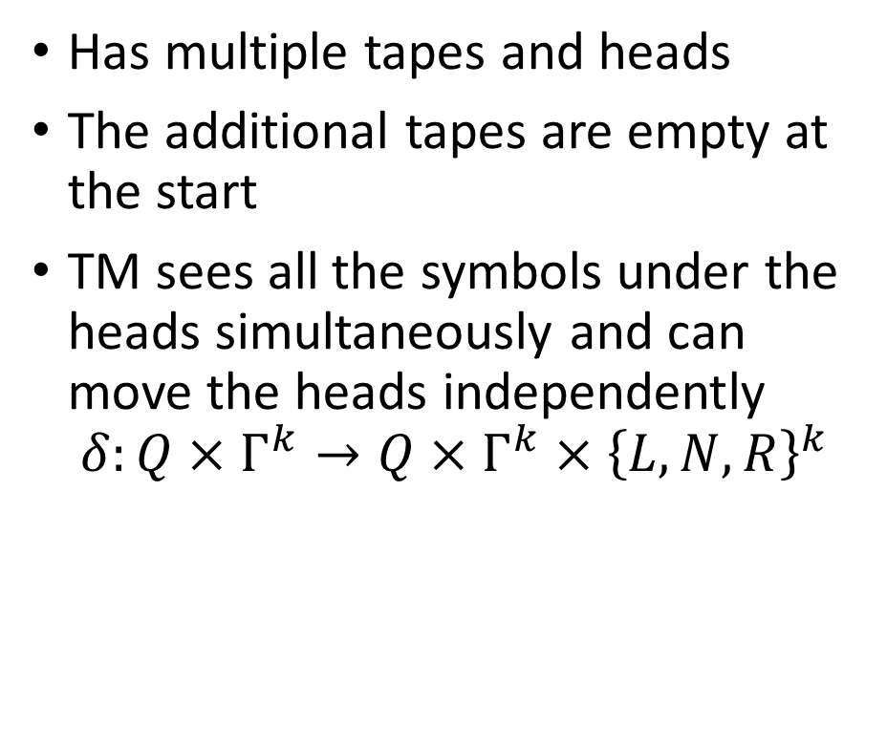



Multi-tape TM
$$q_{0}$$
Has multiple tapes and heads
The additional tapes are empty at the start
TM sees all the symbols under the heads simultaneously and can move the heads independently $δ:Q×Γ^{k}→Q×Γ^{k}×{\left\{L,N,R\right\}}^{k}$
…
$$_$$
_
a
b
c
_
_
…
…
$$_$$
_
_
_
_
_
_
…
…
$$_$$
_
_
_
_
_
_
…
…
$$_$$
_
_
_
_
_
_
…

Slide 109

Multi-tape TM
$$q_{9}$$
Has multiple tapes and heads
The additional tapes are empty at the start
TM sees all the symbols under the heads simultaneously and can move the heads independently $δ:Q×Γ^{k}→Q×Γ^{k}×{\left\{L,N,R\right\}}^{k}$
…
$$_$$
_
a
b
c
_
_
…
…
$$_$$
_
a
_
_
_
_
…
…
$$_$$
_
_
_
_
_
_
…
…
$$_$$
_
c
_
_
_
_
…

Slide 110
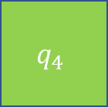
Multi-tape TM
$$q_{4}$$
Has multiple tapes and heads
The additional tapes are empty at the start
TM sees all the symbols under the heads simultaneously and can move the heads independently $δ:Q×Γ^{k}→Q×Γ^{k}×{\left\{L,N,R\right\}}^{k}$
…
$$_$$
_
a
b
c
d
_
…
…
$$_$$
_
_
a
a
_
_
…
…
$$_$$
d
a
1
_
_
_
…
…
$$_$$
_
1
1
0
_
_
…

Slide 111

Multi-tape TM
Every $k$-tape TM can be simulated with a 1-tape TM

Slide 112
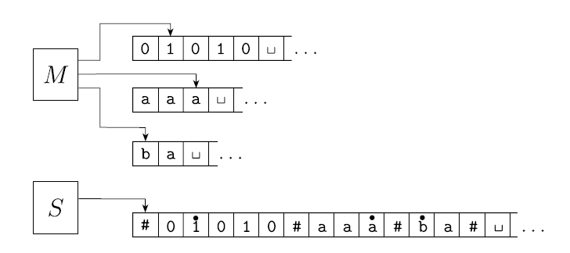
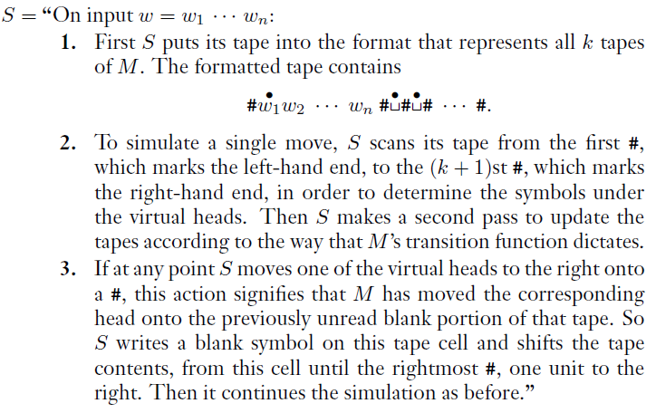

Slide 113
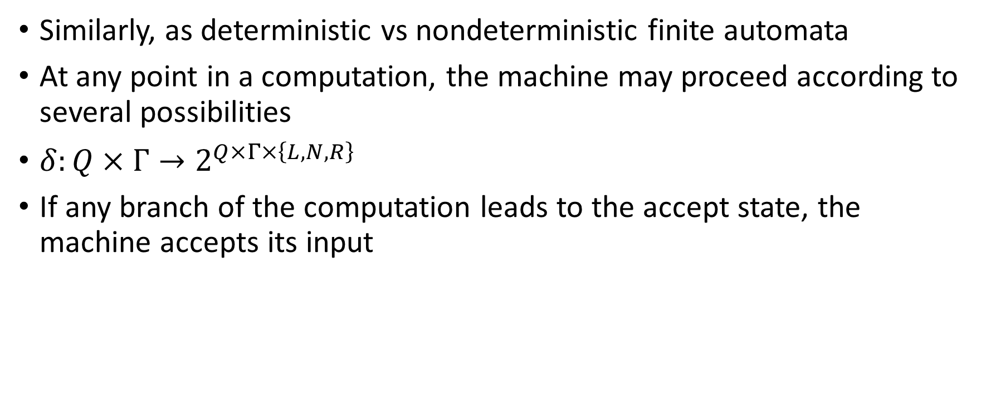
Nondeterministic TM
Similarly, as deterministic vs nondeterministic finite automata
At any point in a computation, the machine may proceed according to several possibilities
$δ:Q×Γ→2^{Q×Γ×\left\{L,N,R\right\}}$
If any branch of the computation leads to the accept state, the machine accepts its input

Slide 114
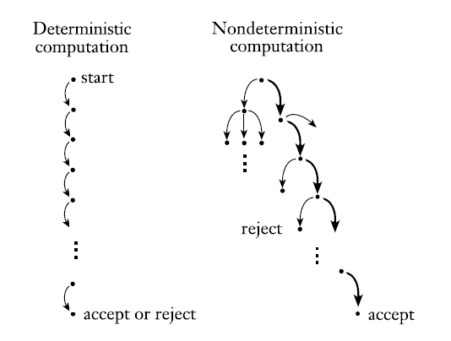
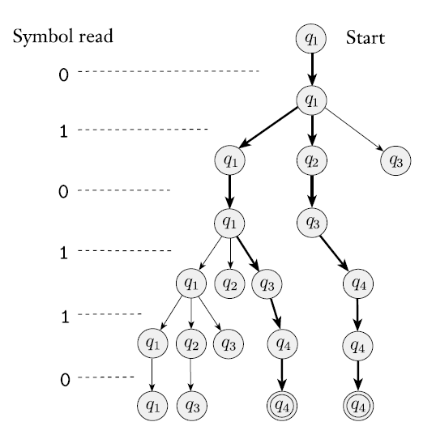

Slide 115
Nondeterministic TM
Every nondeterministic Turing machine has an equivalent deterministic Turing machine.

Slide 116
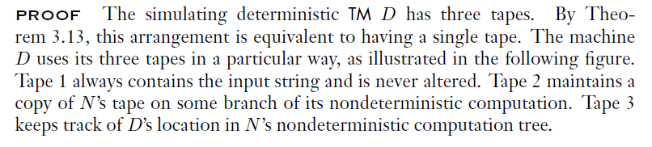
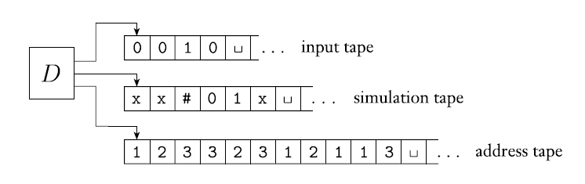
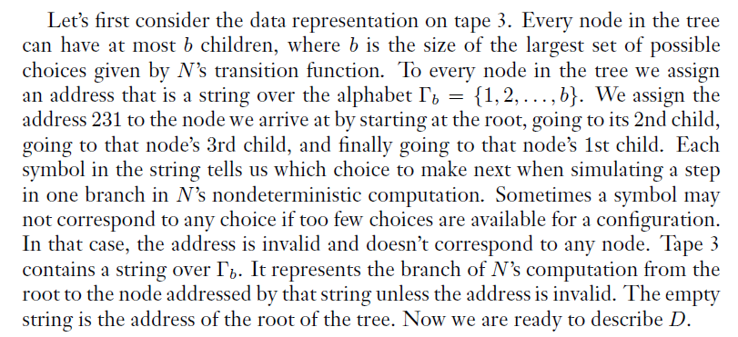
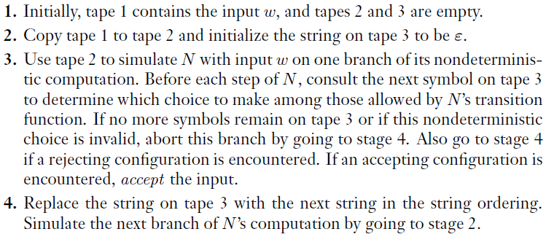

Slide 117
0 _ _ _ _ _ _
1 1 _ _ _ _ _
_ _ _ _ _ _ _
1 _ _ _ _ _ _
0 0 0_ _ _ _
0 0 _ _ _ _ _
0 0 1_ _ _ _
1 1 1 0 1 _ _ _ _
0 1 _ _ _ _ _
1 0 _ _ _ _ _

Slide 118
Enumeration of languages

Slide 119
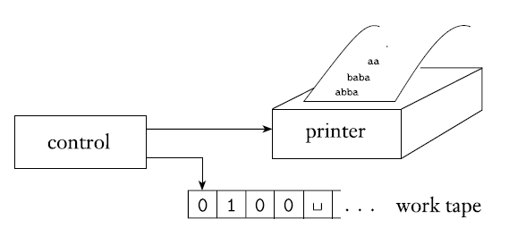




Enumerators
$x$ run $M(x)$, see if accepts/rejects
$$x∈L,x∉L$$
Loosely defined, an enumerator is a Turing machine with an attached printer. The Turing machine can use that printer as an output device to print strings. Every time the Turing machine wants to add a string to the list, it sends the string to the printer.
$$x_{1}\#x_{2}\#x_{3}\#…\#$$
$$L=\left\{x_{1},x_{2},x_{3},…\right\}$$

Slide 120
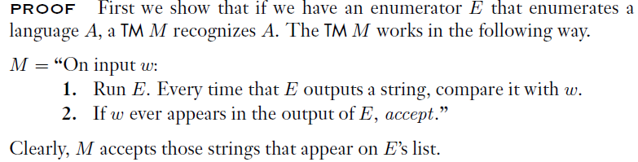
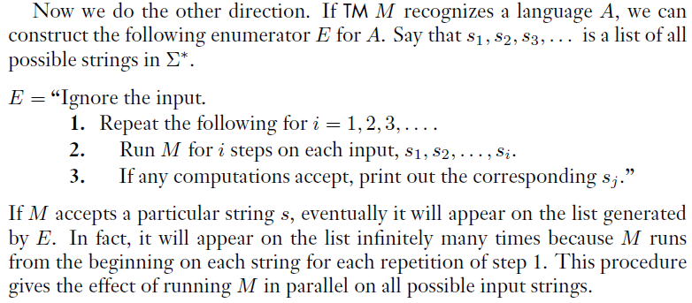
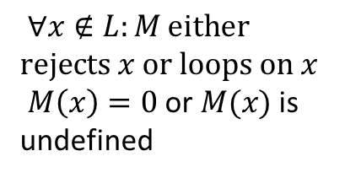
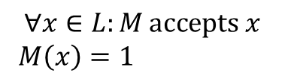
Enumerators
$$∀x∈L:M \text{accepts} x$$
$M\left(x\right)=1$
$∀x∉L:M \text{either} \text{rejects} x \text{or} \text{loops} \text{on} x$
$M\left(x\right)=0$ or $M(x)$ is undefined
A language is Turing-recognizable
if and only if
some enumerator enumerates it.

Slide 121
Church-Turing thesis
Definition of algorithm / computation
Several different models of computation / algoritms
Turing machine (one-tape/multi-tape, deterministic/nondeterministic)
Lambda calculus
Markov’s normal algorithms
Programming languages (C++, C#, Python, Java, Pascal, LISP, etc.)
…
All these models turn out to be equivalent
Algorithms in one model can be simulated in other models
CT thesis: a function on the natural numbers can be calculated by an effective method if and only if it is computable by a Turing machine

